Slide 1

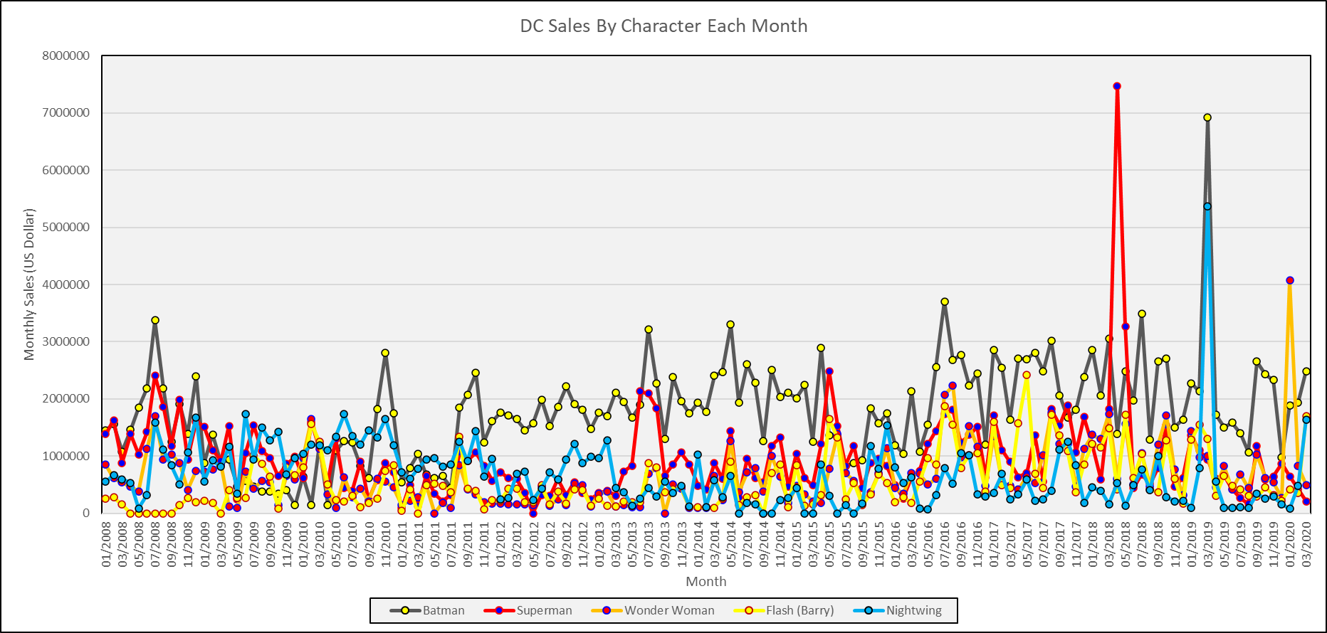
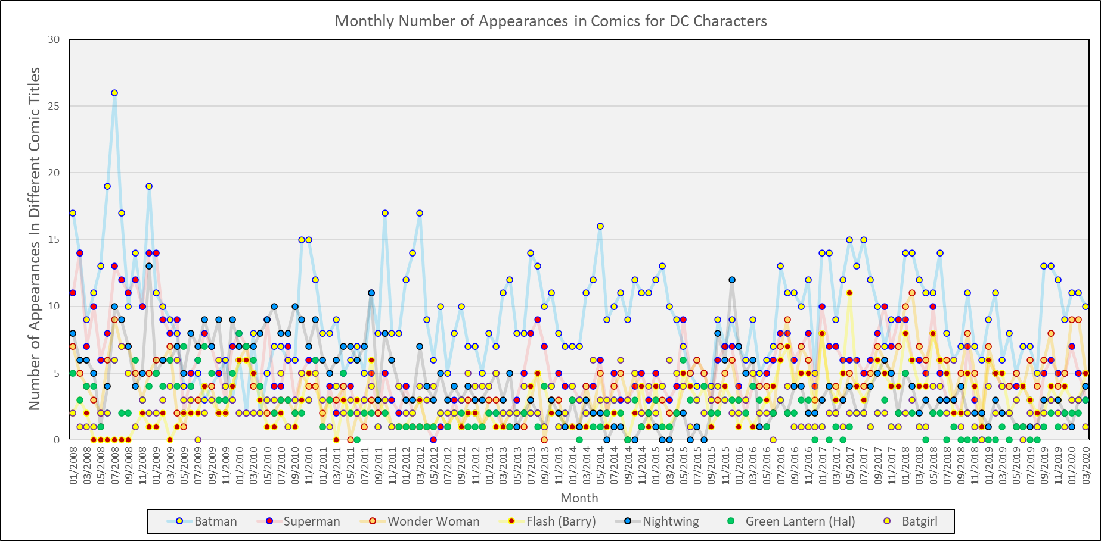
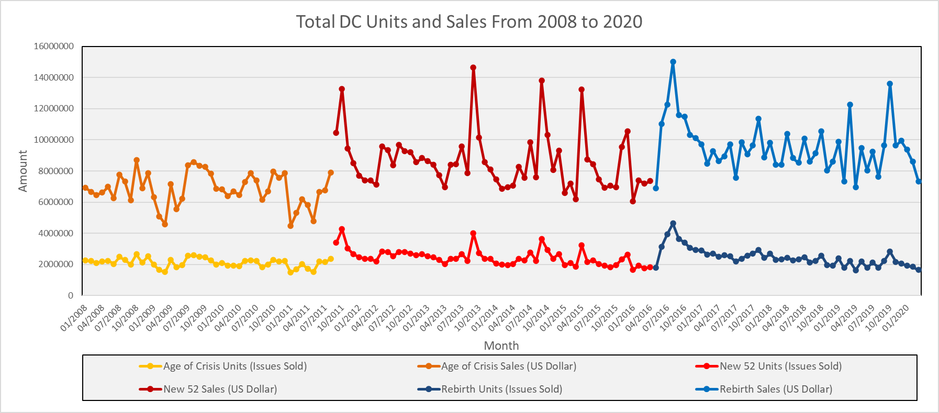
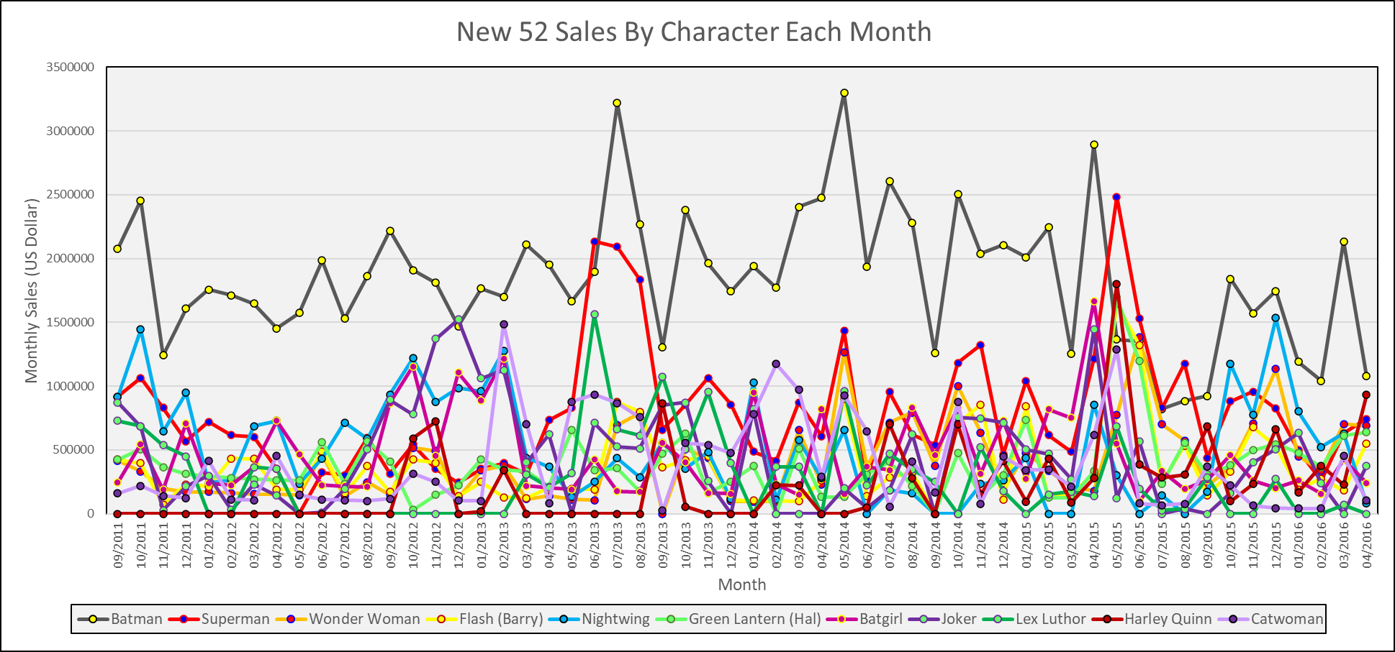
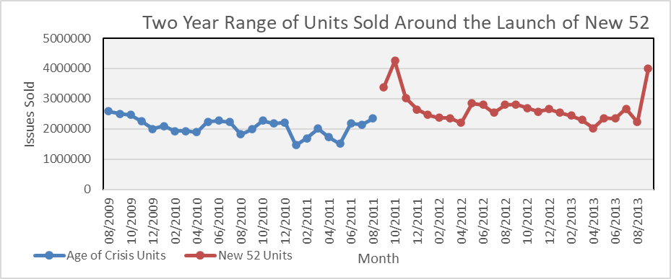
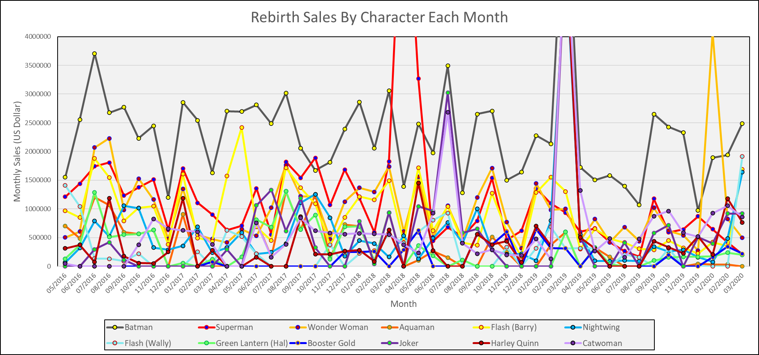
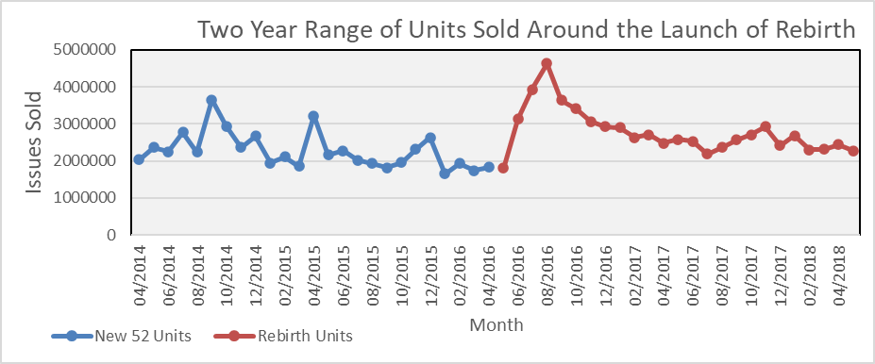

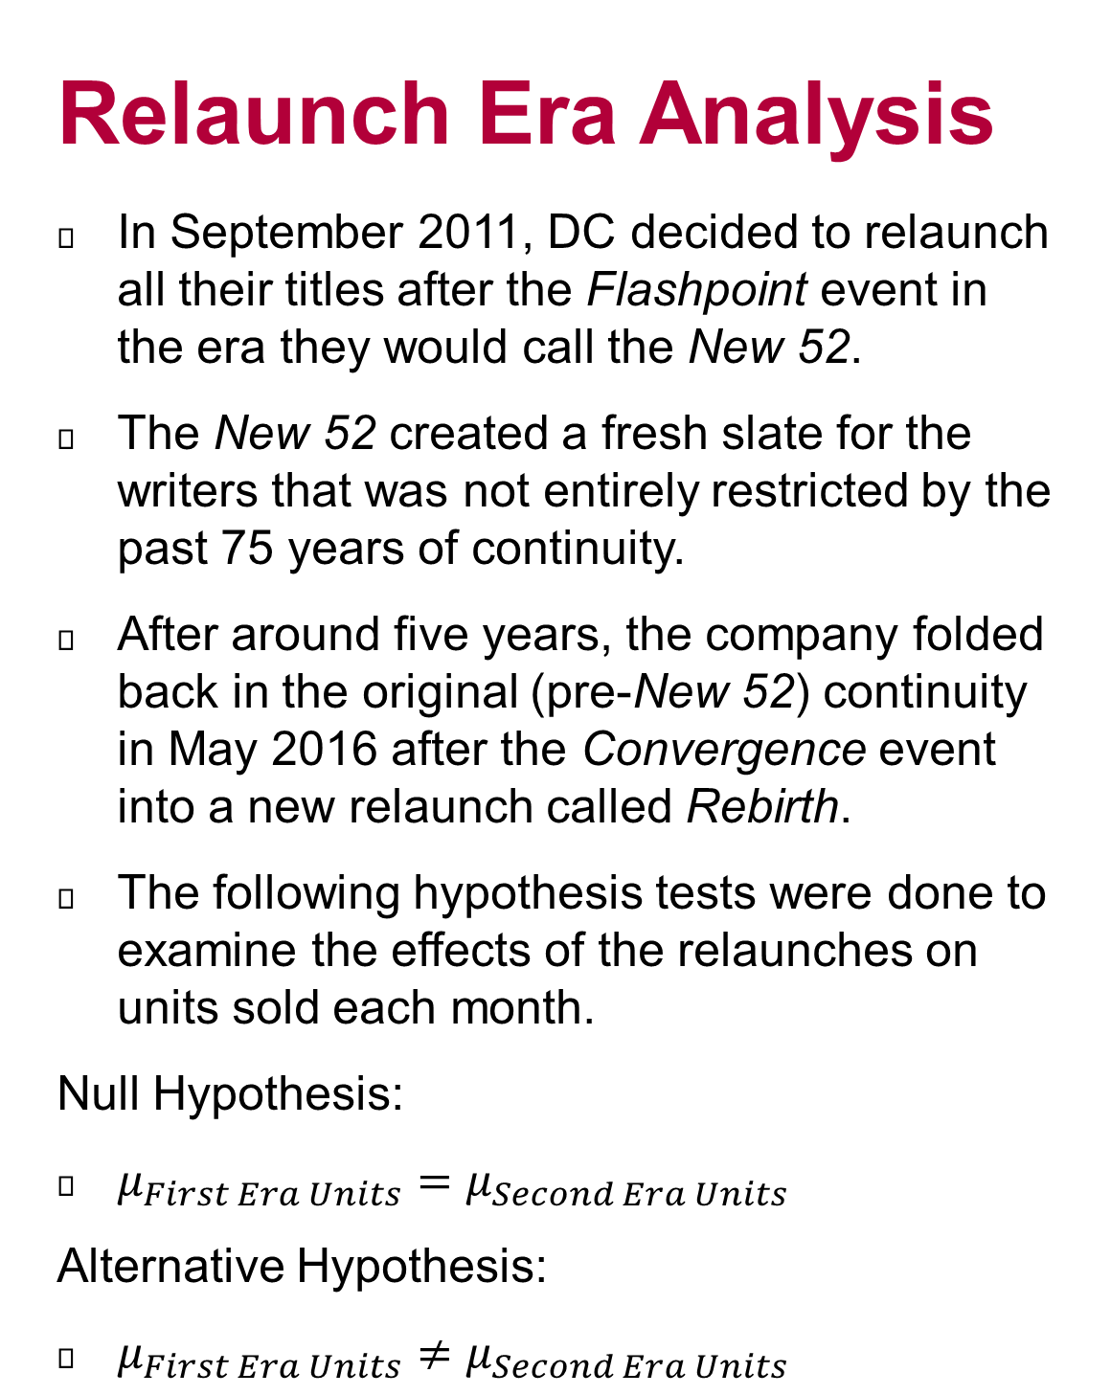
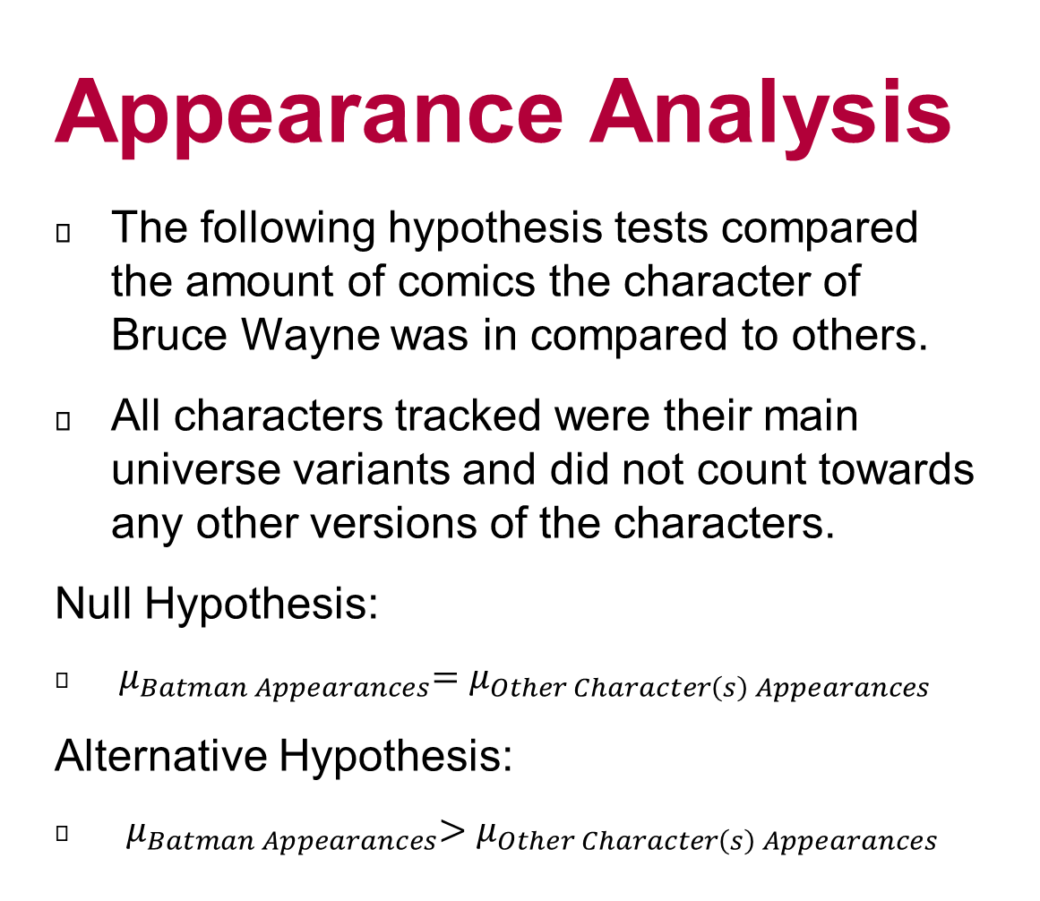
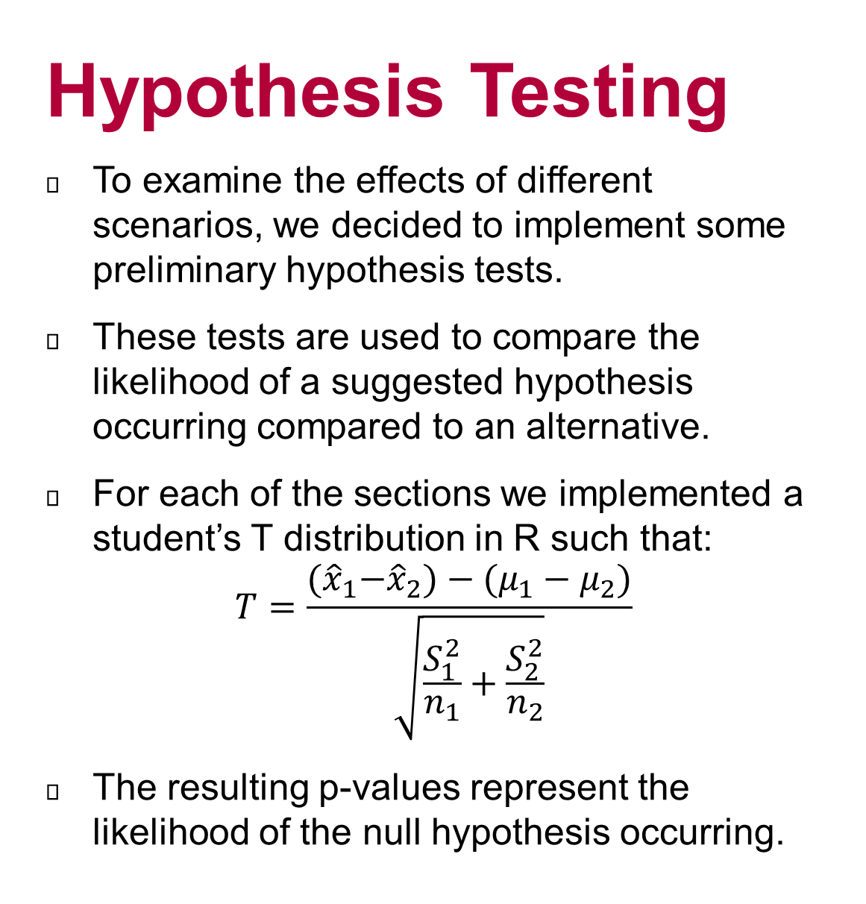
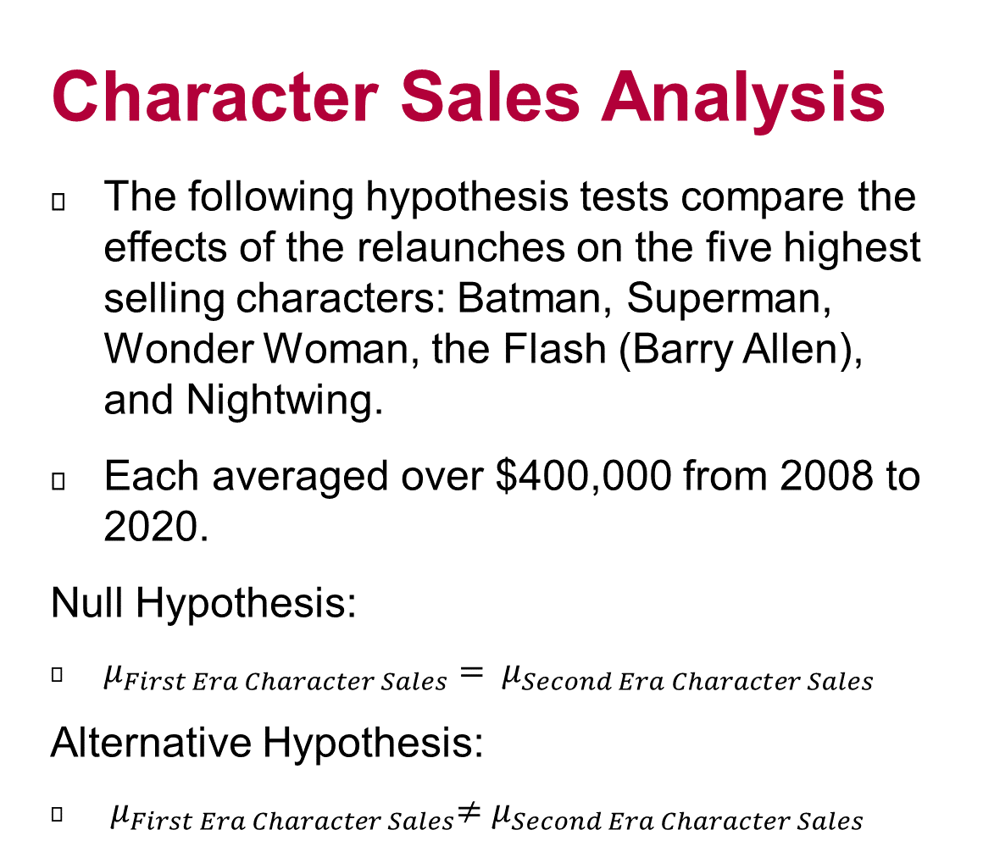
DC Comics Sales: A Retrospective in Another's Cinematic Age
Jacob Prince
Advisor Dr. Amanda Harsy
Background
Since its inception in 2008, the Marvel Cinematic Universe has revolutionized the comic industry by becoming a mainstream juggernaut of pop culture, bringing the themes and characters from the Marvel Comics to more general audiences through its films. Although more Marvel characters are getting their stories shown to the world, the same is not entirely true for their rival company: DC Comics.
DC has its holy trinity of Batman, Superman, and Wonder Woman, but besides a few Justice League members, many of the characters in their expansive comic universe are relatively unknown by most general audiences. With the recent announcements of the plans for a relaunch to the Cinematic Universe for DC, our mission is to examine the company’s past performance within the comic industry in recent years to see if there might be a way to track and predict success of different actions by the company and the resulting sales for characters and titles. In order to develop this model, we must first examine the intricacies of DC’s recent business models for the comics. Those being relaunching the titles and relying more and more on the Batman product.
Relaunch Era Analysis
In September 2011, DC decided to relaunch all their titles after the Flashpoint event in the era they would call the New 52.
The New 52 created a fresh slate for the writers that was not entirely restricted by the past 75 years of continuity.
After around five years, the company folded back in the original (pre-New 52) continuity in May 2016 after the Convergence event into a new relaunch called Rebirth.
The following hypothesis tests were done to examine the effects of the relaunches on units sold each month.
Null Hypothesis:
$μ_{First Era Units}=μ_{Second Era Units}$
Alternative Hypothesis:
$μ_{First Era Units}≠μ_{Second Era Units}$
Character Sales Analysis
The following hypothesis tests compare the effects of the relaunches on the five highest selling characters: Batman, Superman, Wonder Woman, the Flash (Barry Allen), and Nightwing.
Each averaged over $400,000 from 2008 to 2020.
Null Hypothesis:
$μ_{First Era Character Sales}= μ_{Second Era Character Sales}$
Alternative Hypothesis:
${ μ}_{First Era Character Sales}≠μ_{Second Era Character Sales}$
Appearance Analysis
The following hypothesis tests compared the amount of comics the character of Bruce Wayne was in compared to others.
All characters tracked were their main universe variants and did not count towards any other versions of the characters.
Null Hypothesis:
${ μ}_{Batman Appearances}=μ_{Other Character\left(s\right) Appearances}$
Alternative Hypothesis:
${ μ}_{Batman Appearances}>μ_{Other Character\left(s\right) Appearances}$
Data and Sorting
Utilizing the Comichron Database, we scraped the site for the top 300 issues per month from January 2008 until March 2020. The data itself is an estimate of comic sales based on final order information provided by comic distributers.
With the raw data, we refined it even further by utilizing a custom pandas program for python that would compare each issue to its appearance on the DC Fandom Database.
Each DC Fandom issue page contained a prioritized list of Featured Characters, Supporting Characters, and Antagonists.
Each of the characters listed in the above sections, contained a link to their respective individual pages which accounted for multiversal variants to be individually tracked.
The current character information we were able to track were then Monthly Units Sold, Monthly Sales, and Monthly Number of Comics In.
Action Comics #1000
Detective Comics #1000
Wonder Woman #750
New 52 Launch
Rebirth Launch
Batman Appearance Comparison P-Values
Scenario | 2008 - 2020 | End of Age of Crisis | New 52 | Rebirth
Batman / Superman | 2.20E-16 | 0.016 | 2.20E-16 | 2.28E-12
Batman / Top 5 | 2.20E-16 | 5.96E-06 | 2.20E-16 | 2.20E-16
Batman / All Characters | 2.20E-16 | 9.69E-11 | 2.20E-16 | 2.20E-16
All Characters: Batman, Superman, Wonder Woman, Flash (Barry Allen and Wally West), Nightwing, Aquaman, Green Lantern (Hal Jordan, John Stewart, and Kyle Rayner), Martian Manhunter, Shazam, Green Arrow, Supergirl, Hawkman, Black Canary, Zatanna, John Constantine, Dr Fate, Blue Beetle, Booster Gold, Swamp Thing, Joker, Lex Luthor, Harley Quinn, Deathstroke, and Catwoman
Hypothesis Testing
To examine the effects of different scenarios, we decided to implement some preliminary hypothesis tests.
These tests are used to compare the likelihood of a suggested hypothesis occurring compared to an alternative.
For each of the sections we implemented a student’s T distribution in R such that:
$$T=\frac{{(\hat{x}}_{1}−{\hat{x}}_{2})−(μ_{1}−μ_{2})}{\sqrt{\frac{S_{1}^{2}}{n_{1}}+\frac{S_{2}^{2}}{n_{2}}}}$$
The resulting p-values represent the likelihood of the null hypothesis occurring.
Future Work
We would like to sort the data by the specific issue title information like Detective Comics, Action Comics, etc.
We would like to examine the effects of outside media influence on the comics like films, television, and video games.
We would like to sort the data provided by Comichron’s Top 300 Graphic Novels database for each month.
We would like to track other features for the issues like authors, artists, and reception to look for additional reasons for sales changes.
We would like to develop a predictive model for sales based upon our discovered features in the previous work.
Top 5 Character Sales Comparison P-Values
Scenario | Batman | Superman | Wonder Woman | Flash | Nightwing
Total Age of Crisis Sales to Total New 52 Sales | 6.39E-07 | 0.08365 | 0.02643 | 0.7564 | 1.34E-08
Total New 52 Sales to Total Rebirth Sales | 0.003892 | 0.03017 | 7.78E-07 | 2.01E-07 | 0.6873
Two Years from New 52 Launch Comparison | 1.27E-07 | 0.8879 | 0.01489 | 0.01555 | 6.28E-06
Two Years from Rebirth Launch Comparison | 0.001854 | 0.01645 | 0.0004707 | 2.79E-05 | 0.221
Relaunch Era Comparison P-Values
Scenario | Age of Crisis to New 52 | New 52 to Rebirth
Total Time Period Comparison | 7.04E-05 | 0.9526
Two Years from Launch Comparison | 8.00E-06 | 0.00185
One Year from Launch Comparison | 9.57E-05 | 0.0005806
GitHub:

